Slide 1
Lynx-PixelSense Secure Transfer
Team Argus 05/14/2015

Slide 2
Overview
Introduction
Requirements
Architecture
Risk Analysis
Project Management
Prototype and Testing

Slide 3
Team Roles
Seth | Shamikul | Keyur | Brandon | Brian
Team Lead, Hardware Lead. | Software Lead, Hardware Co-Lead | Architect, Change Management/ Configuration Management | Risk Assessment, Document Editor/ Document Analyzer | QA Lead, Product Design / Game Design
Computer Engineer | Computer Science | Software Engineering | Software Engineering | Computer Science

Slide 4
Introduction
What is it
Secure Transfer System
2-way optical communication
utilizing array of LED’s and photodiodes
What does it do
sends and receives binary data
using PixelSense table and Android device

Slide 5
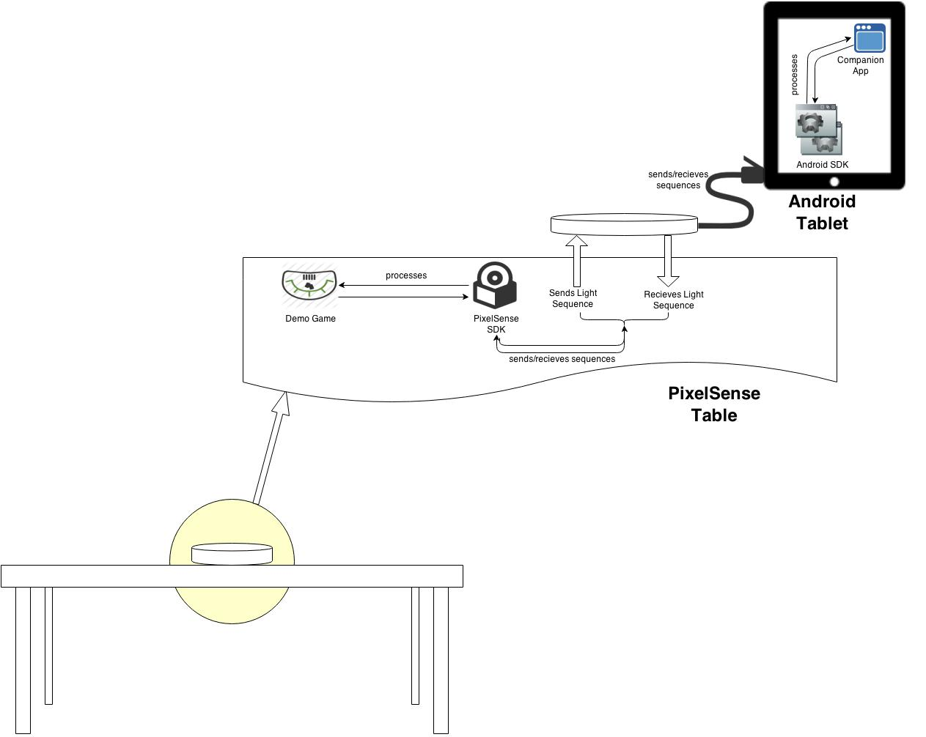



Project Overview

Slide 6
SDK & Customer Requirements
No. | Requirement | Priority | Status
1 | The product will be able to send data optically | Very High | COMPLETE
2 | The product will be able to read data optically | Very High | COMPLETE
3 | All work done by the product involving optical communication will be compiled into a well documented library. | Very High | COMPLETE
4 | The device must have a serial port to transfer data collected. | Very High | COMPLETE
5 | The device and table’s communication should be error tolerant. | High | INCOMPLETE

Slide 7
SDK & Customer Requirements
No. | Requirement | Priority | Status
6 | Communication between both devices must sustain a reliable connection. | High | COMPLETE
7 | Software will be built to showcase the optical transfer protocol and the built device. | Very High | COMPLETE
8 | The system will support Android API 17 and Surface 2.0 platforms. | Very High | COMPLETE
9 | The system will support customizable light sequences. | Moderate | COMPLETE
10 | The system will allow the expansion of the array. | High | PARTIAL

Slide 8
SDK & Customer Requirements
No. | Requirement | Priority | Status
11 | The system will support a 4x4 array of transmitters and receivers. | High | COMPLETE
12 | The system will authenticate the Lynx device when plugged into the tablet. | High | COMPLETE
13 | The system will authenticate that a valid Lynx device is placed on the PixelSense table. | Very High | COMPLETE
14 | The system will notify the Android device if the Lynx is on the table. | Very High | INCOMPLETE
15 | The system will notify the table that the Lynx is on it. | Very High | COMPLETE

Slide 9
SDK & Customer Requirements
No. | Requirement | Priority | Status
16 | The system will be able to determine the orientation of the Lynx. | Very High | PARTIAL
17 | The system will support multiple devices. | Moderate | PARTIAL

Slide 10
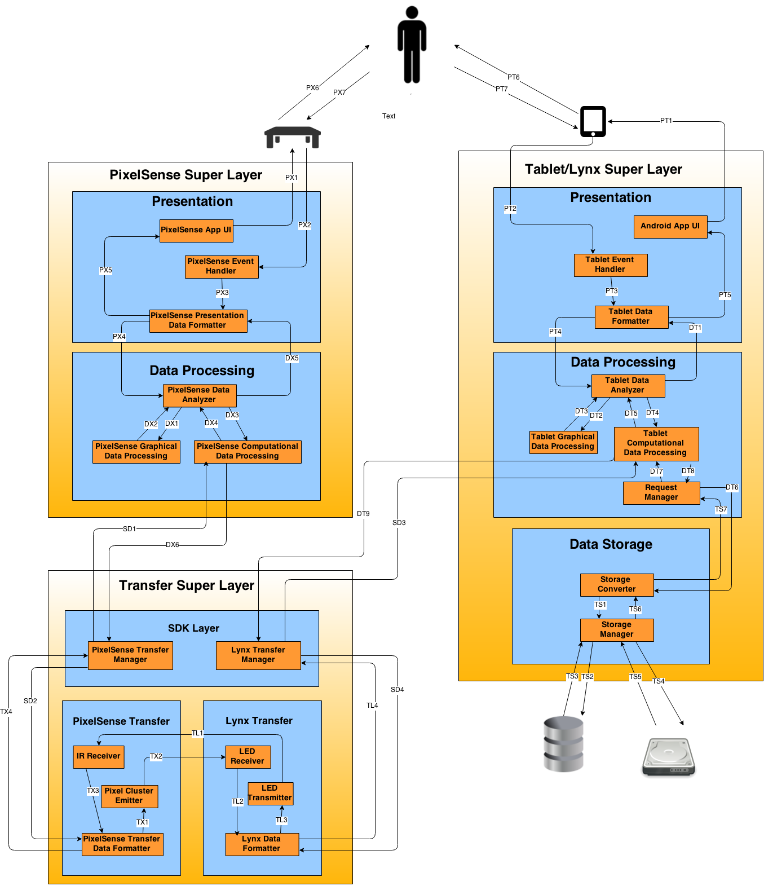
Architecture Design
Notes:
Using to define general approach, and introduce Super Layers

Slide 11
Architectural Design Philosophy
Three Super Layers
Discrete Design
Two-way Pipeline
Notes:
Re-iterate the Super Layer’s organizational advantage
describe the purposeful limitation for super layer entry points
Demonstrate/Explain the pipeline ideology and A - B process

Slide 12
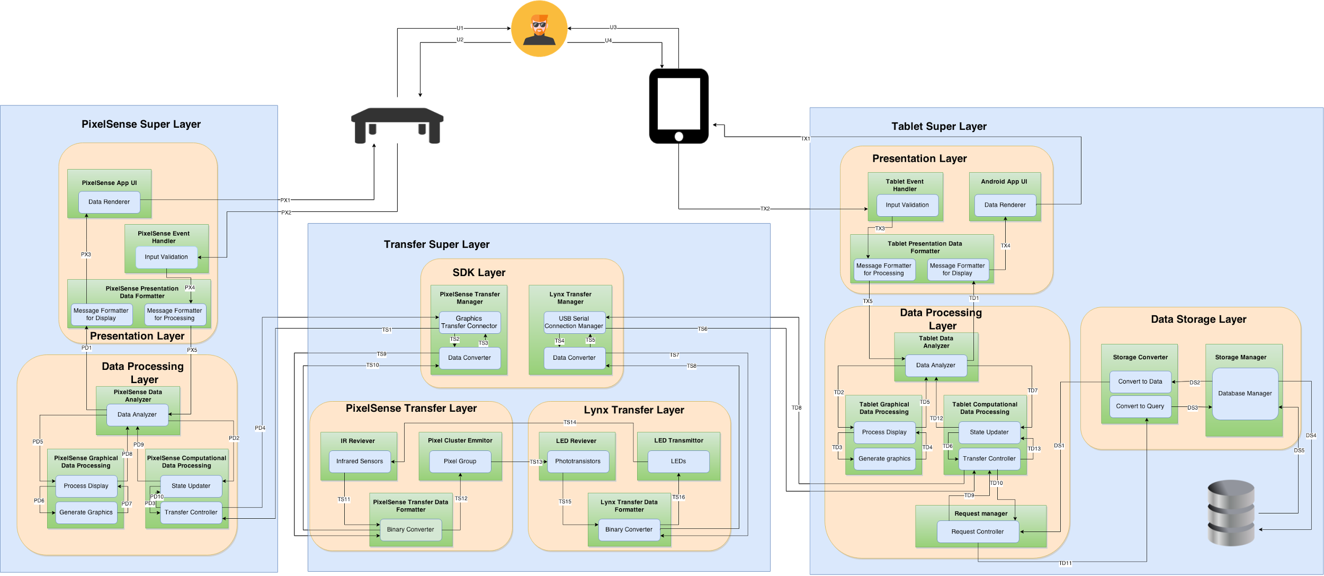
Detailed Design
Notes:
Demonstrate follow through of those design principles in the detailed design. Overview only.

Slide 13
Risk Analysis
Risk | Setback (weeks) | Containment
PixelSense Not functioning correctly (Environmental lighting effecting table) | 1 | black out light sources (window and lights by cubicle)
Software Integration Issues (Tag Visualization & XNA) | 4 | Recreate the blackjack game in WPF and throw away XNA game
Team Member’s Unavailable to Work (Bogged down due to other course work) | 2 | Redistribute workload among available team members
New Technology Learning Curve (Technology new to us, Android Studio, PixelSense, VisualStudio...) | 4 | Research & experiment with the technology

Slide 14
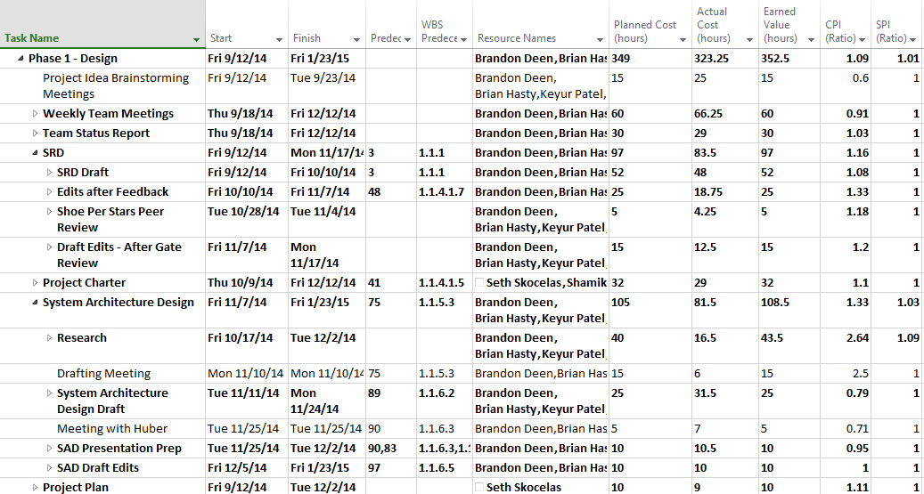
Project Management

Slide 15
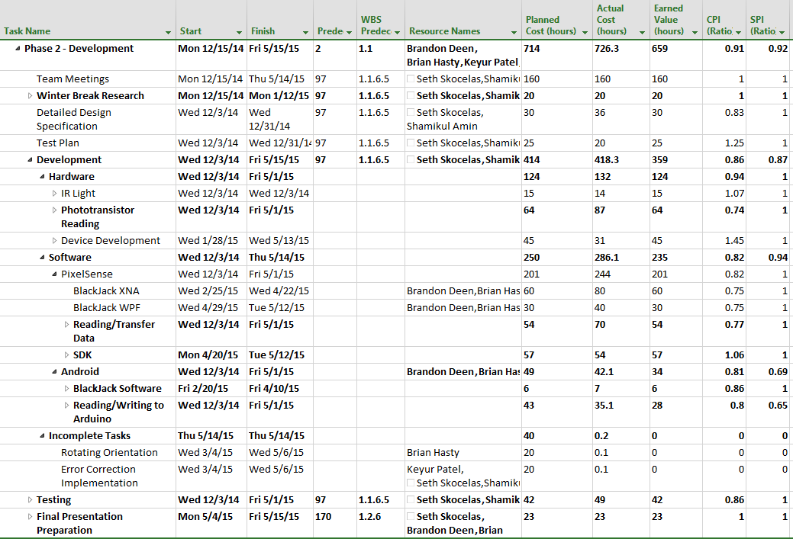
Project Management

Slide 16
Project Management
Overall Cost Analysis
Planned Cost | 1063 hours total
Actual Cost | 1049.55 hours
Earned Value | 1011.5 hours
CPI | .96
SPI | .95

Slide 17
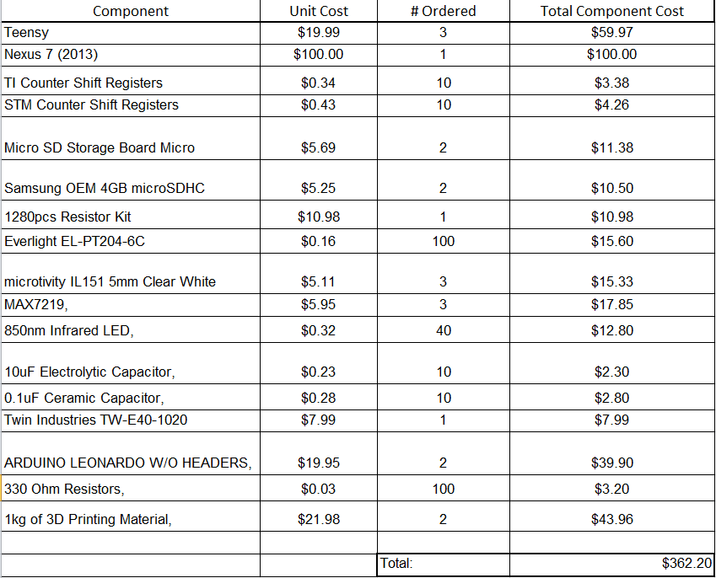
Project Costs

Slide 18
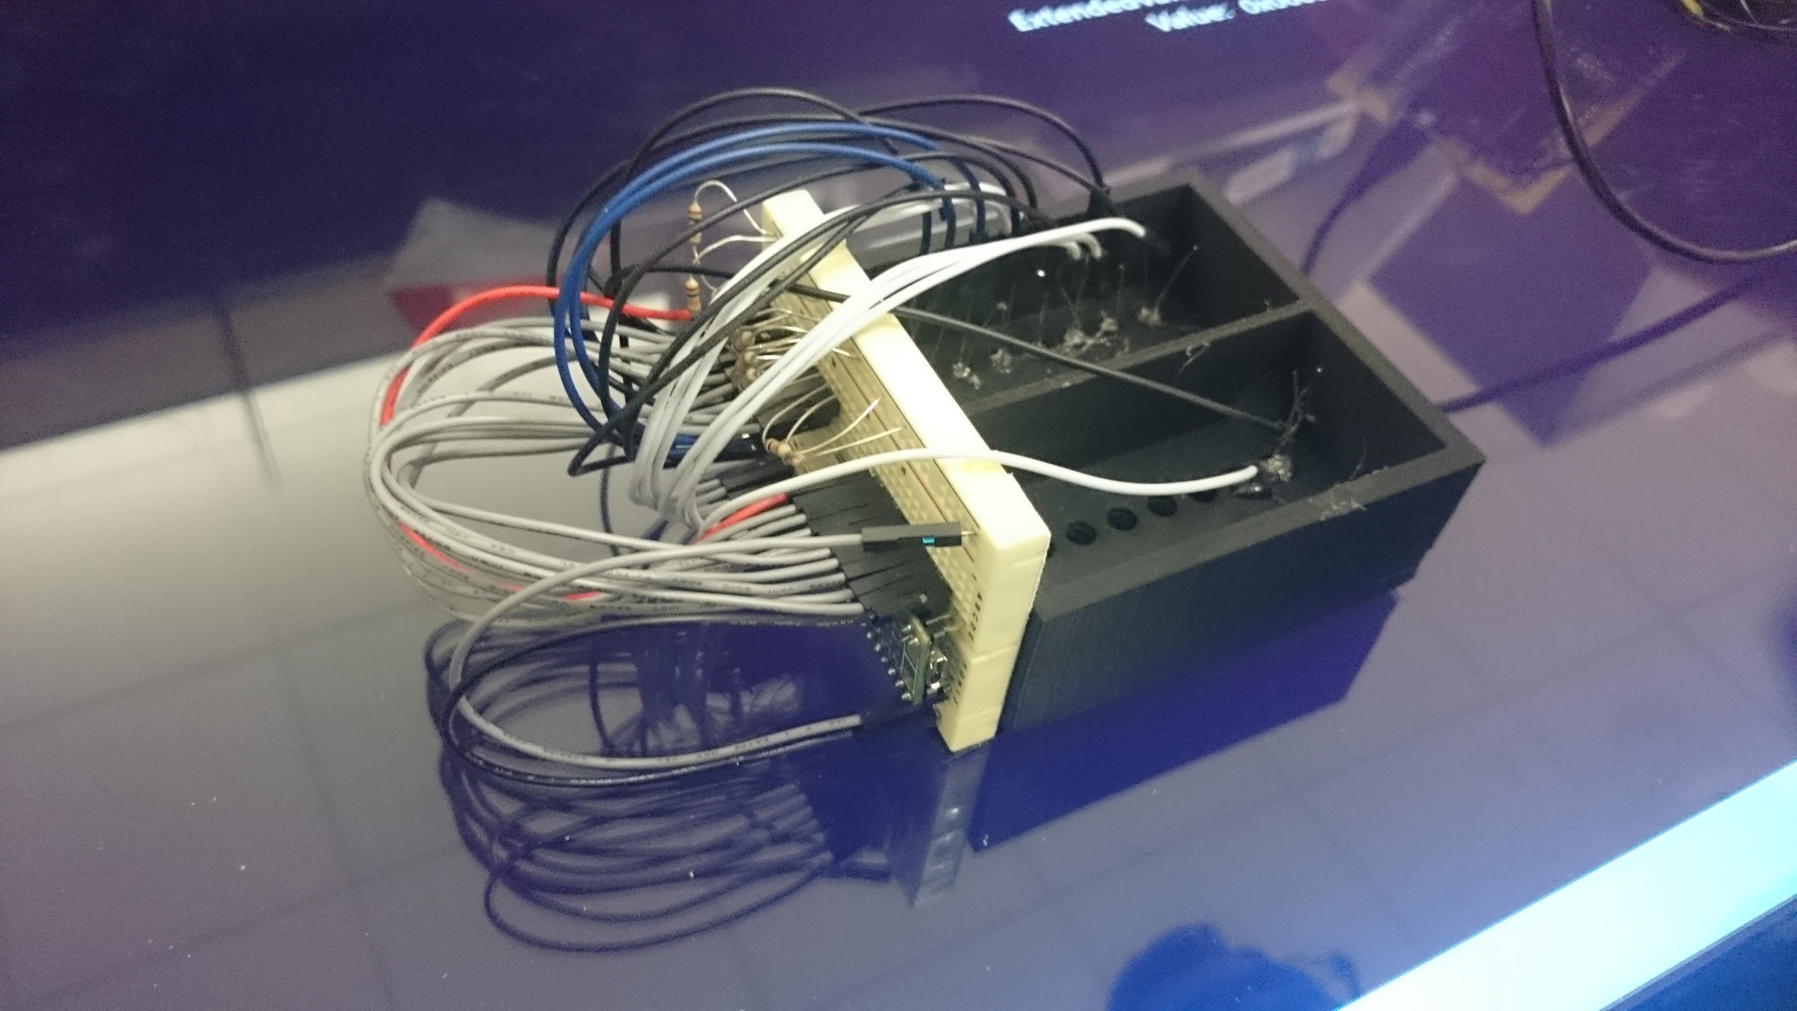
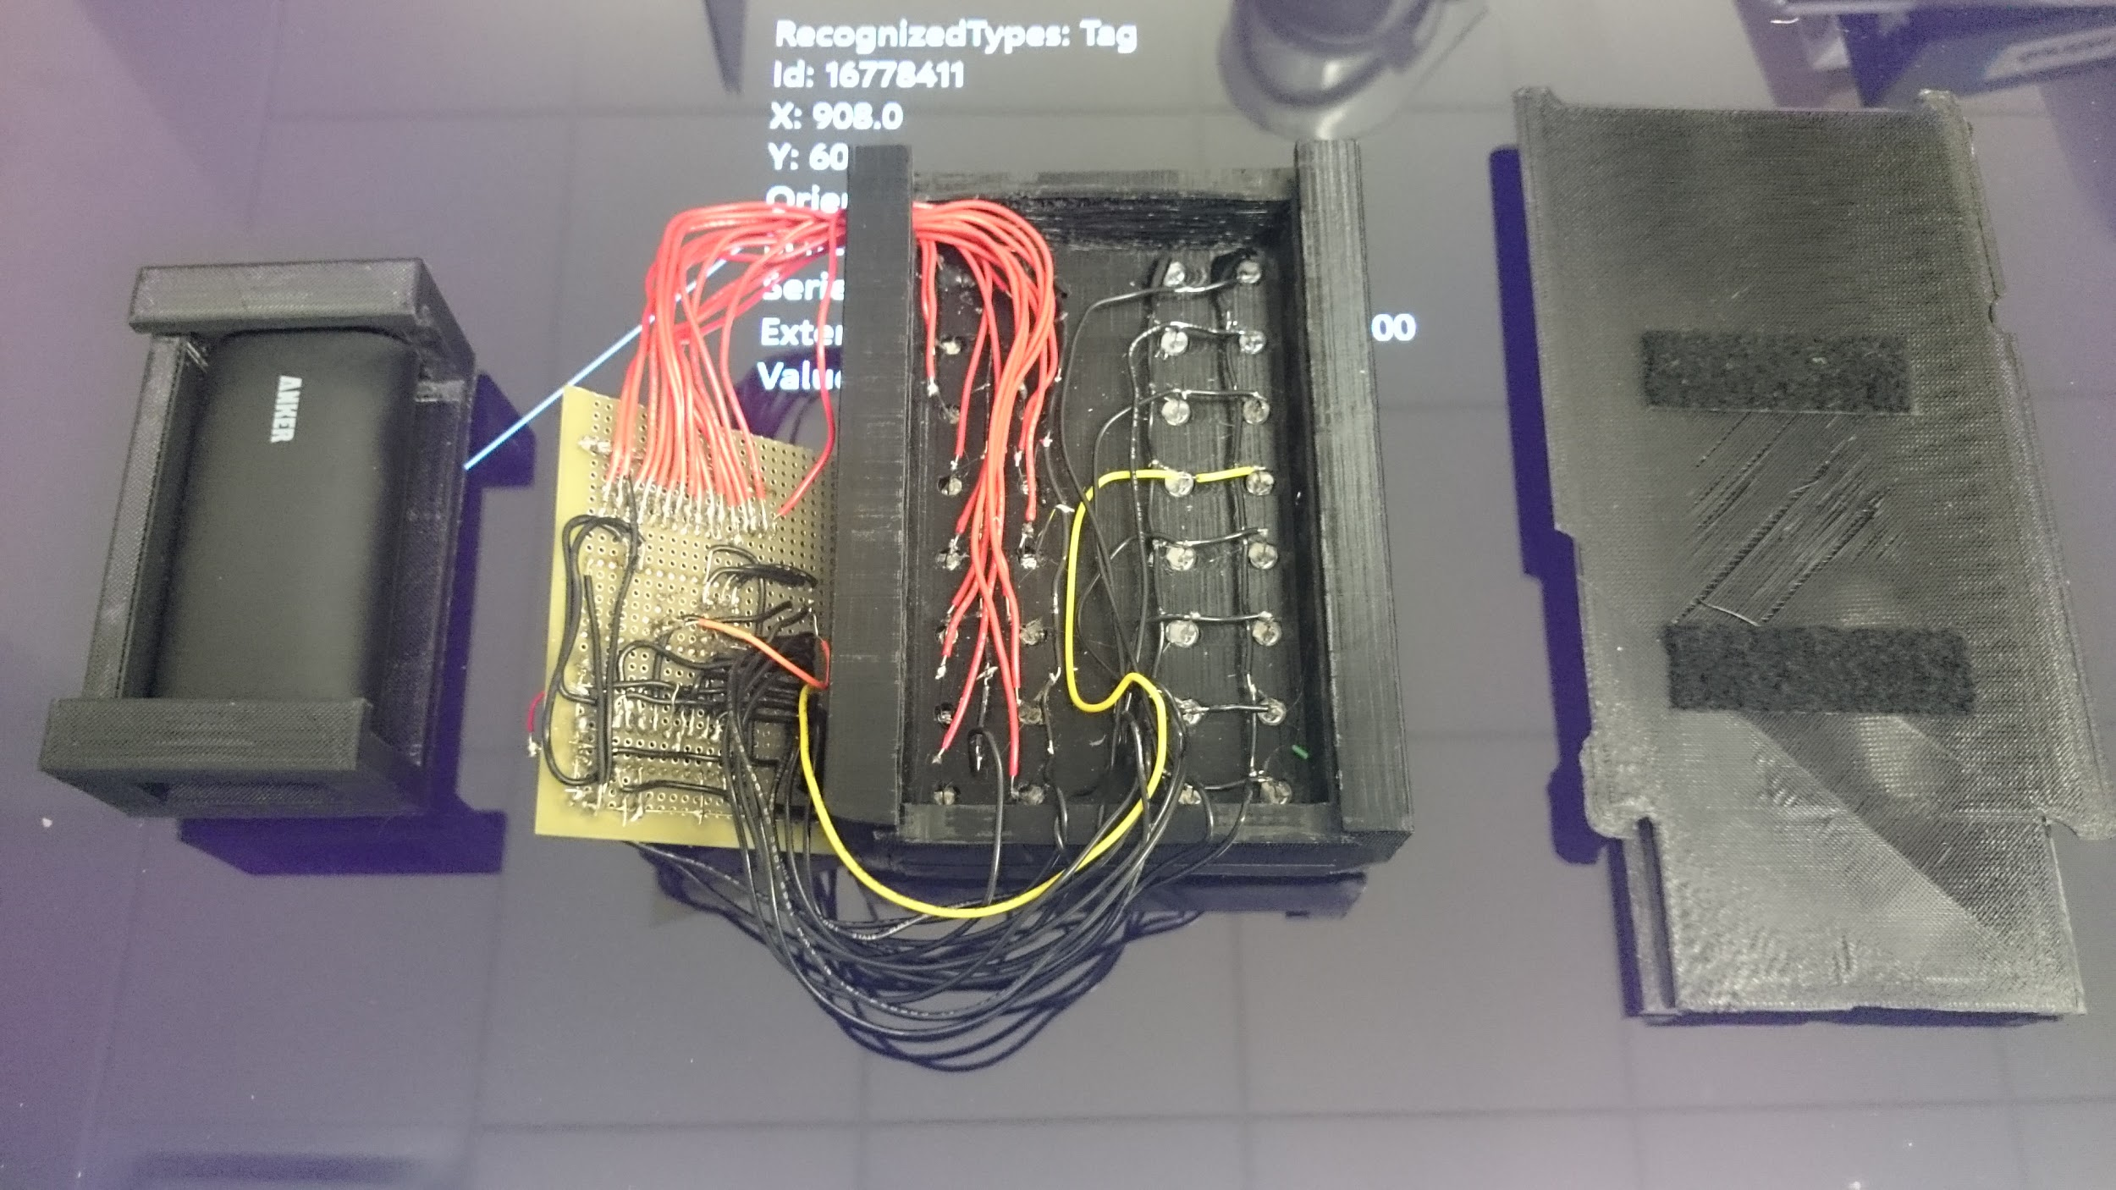
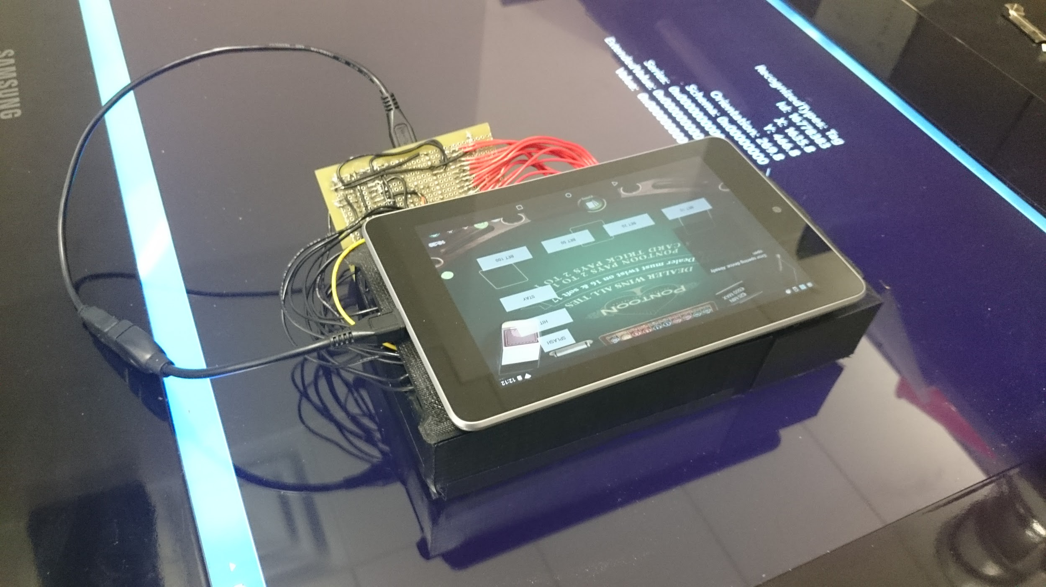
Prototype & Testing

Slide 19
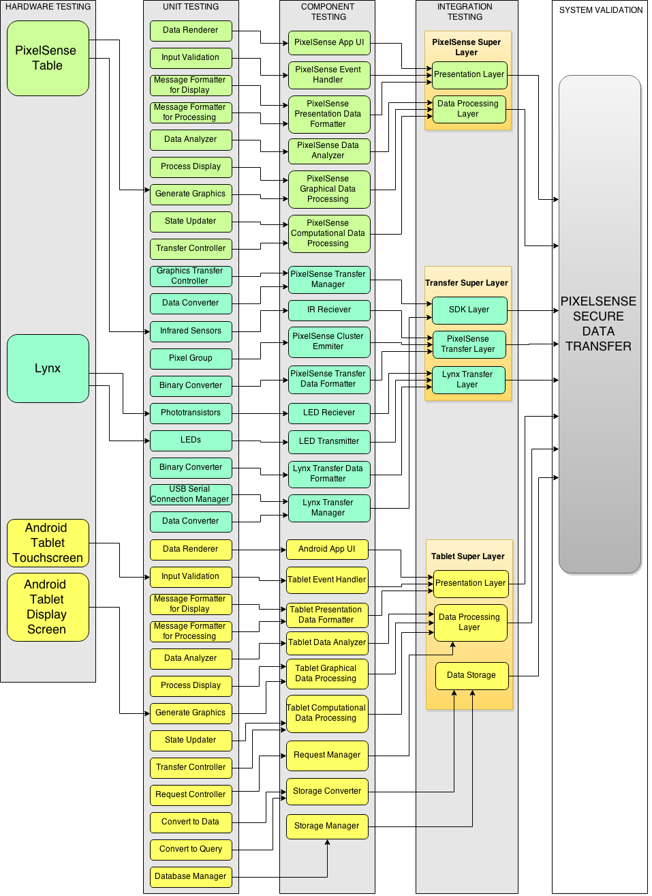
Prototype & Testing

Slide 20
Prototype & Testing
Customer Requirements
Requirement | Test Method | Result
The product shall be able to send/read data optically. | Send/receive data via IR leds and phototransistors | COMPLETE
The device must have a serial port to transfer data collected. | Transfer data via serial through Teensy and tablet. | COMPLETE
The device and table’s communication should be error tolerant | Send data one way and check if it is the same on the output end | PARTIAL
Communication between both devices must sustain a reliable connection. | Check if data connection breaks during sending (are all the expected data received?) | COMPLETE
Software will be built to showcase the optical transfer protocol and the built device. | Create a BlackJack game which will use 2-way transfer via light | COMPLETE

Slide 21
Prototype & Testing
SDK Requirements
Requirement | Test Method | Result
The system will support Android API 17 and Surface 2.0 platforms | Develop application for Android API 17 and use the Surface 2.0 SDK | COMPLETE
The system shall allow error correction when transferring data | Implement an error correction system (such as hamming codes or CRC) | INCOMPLETE
The system shall allow the expansion of the array | Integrate different array sizes | PARTIAL
The system shall support a 4x4 array of transmitters and receivers | Device can be rearranged from 8x2 to 4x4 with new hardware. | COMPLETE
The system shall allow the Lynx to send and receive data | Send data back and forth via the BlackJack application. | COMPLETE

Slide 22
Prototype & Testing
SDK Requirements
Requirement | Test Method | Result
The system shall allow the PixelSense to send and receive data | Send data back and forth via the BlackJack application and Android application. | COMPLETE
The system shall be able to determine the orientation of the Lynx | The application base should rotate with the rotation of the physical lynx. | PARTIAL
The system shall notify the Android device if the Lynx is on the table | Android application should go from wait screen to game screen when lynx is placed. | INCOMPLETE
The system shall notify the table that the Lynx is on it. | Application should get the tag value when the Lynx is placed on the table | COMPLETE
The system shall authenticate that a valid Lynx device is placed on the PixelSense table. | Game will only start when a Lynx with a valid tag is placed on the table. | COMPLETE

Slide 23
Prototype & Testing
Packaging Requirements
Requirement | Test Method | Result
Attachable to Tablet | Tablet should be removable from the Lynx | COMPLETE
Fully Assembled | Lynx should be fully assembled and ready to use | COMPLETE
Lynx as a Tablet Case | The Lynx should be a protective cover for the tablet. | PARTIAL
SDK on USB Flash Drive | The SDK should be on a flash drive | COMPLETE
PixelSense Casino Software | Software should have a suite of casino games | PARTIAL

Slide 24
Prototype & Testing
Performance Requirements
Requirement | Test Method | Result
Minimum Data Transfer Rate of 200b/s | Send a large amount of data over a short period of time | COMPLETE
Data Translation to binary at most 1 second | Time how long it takes a light sequence to be converted | COMPLETE
Authentication Time at most 5 seconds. | Time how long it takes for the table to detect the valid tag | COMPLETE

Slide 25
Prototype & Testing
Postponed Requirements
Implement a more robust application
Have the transfer be a lot more smoother
Implement an error correction mechanism
Attempt to achieve a higher accuracy rate.

Slide 26
Lessons Learned
Start implementation as soon as possible
Determine the best components to use by testing many types in the beginning
Avoid taking hard courses /take the minimum amount of courses during Senior Design II
Minimize design changes and be sure to communicate them with the entire group.

Slide 27

Questions?

